Slide 1
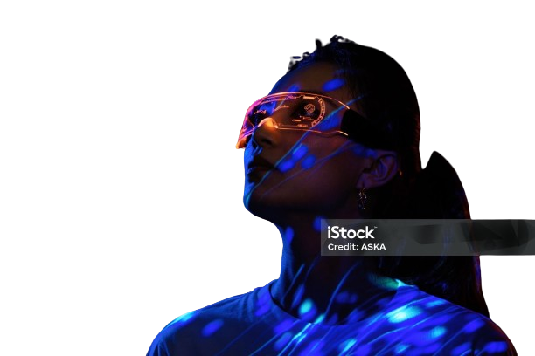
Team Name – Innovators
Team Member –
Arpit Tripathi
Hrithik
Priyanshi Shah
Nidhi

Slide 2
Table Content :-
Introduction
Plan
Architechture
Data Files
AI ML
UI UX
Team Member
Shippable

Slide 3

Introduction
Welcome to the auto ml project, a comprehensive solution designed to simplify and streamline the process of creating and deploying machine learning models. Our platform integrates cutting-edge technology with an intuitive user interface to make advanced machine learning accessible to users of all skill levels. The auto ml project offers a seamless end-to-end experience, guiding users through each crucial step of the machine learning pipeline. Our platform ensures that you can efficiently handle your data and create powerful models without extensive technical expertise.

Slide 4
Navigation Overview
On the front page of our AutoML Project, you will find easy access to the following key functionalities:
Data Ingestion: Effortlessly import datasets from various sources, ensuring your data is ready for analysis and modeling.
Exploratory Data Analysis (EDA): Gain insights into your data through visualizations and summary statistics, helping you understand the underlying patterns and relationships.
Data Transformation: Enables the creation of new features through transformations or aggregations based on existing data. Allows the removal of unnecessary or redundant features to streamline the dataset and improve model performance
Modeling: Automatically train and evaluate multiple machine learning models to identify the best performing model for your data, saving you time and effort.
Download: Export your trained models and processed data for deployment or further analysis, ensuring you can leverage your results in real-world applications.
With the AutoML Project, we aim to empower users to harness the full potential of machine learning, making the journey from raw data to predictive models as smooth and efficient as possible.

Slide 5
Plan
Requirements Gathering
Design and Architecture
Frontend Development
Backend Development
Integration and Testing
Success Metrics

Slide 6
Architechture
Components:-
1. Frontend
Technology Stack: Streamlit
Responsibilities:
User Interface: Provides an intuitive and interactive interface for data ingestion, exploratory data analysis (EDA), data transformation, model training, and result downloading.
Features: Interactive widgets (file uploaders, sliders, buttons), data visualization (charts, graphs), and user authentication.

Slide 7
Backend
Technology Stack: Python
Responsibilities:-
Model Training: Utilizes machine learning libraries like ydata_profiling and pycaret for model training and evaluation.
Machine Learning: Implements automated model selection, hyperparameter tuning, and performance evaluation.

Slide 8
Data Files
User Data:- User id and password
Dataset Metadata: - Contains metadata about uploaded datasets such as dataset name, upload date, file path, and user ID.
Model Results:-Records details of trained models, including model type, accuracy, parameters, and associated dataset.
Logs:- Captures system logs for debugging and monitoring.

Slide 9
AI And ML
Automated Model Selection:
Feature Engineering:
Model Evaluation:
Model Deployment:

Slide 10
UI UX
For the AutoML Project, I am using the Streamlit framework to design the UI and UX. Streamlit enables rapid development of interactive web applications with a simple and intuitive API. It allows for seamless creation of data ingestion interfaces, interactive visualizations for exploratory data analysis, user-friendly data transformation tools, and straightforward model training and evaluation pages. Streamlit’s real-time updates and responsive design enhance user experience, making it easy to interact with complex machine learning workflows efficiently. This approach ensures a modern, streamlined interface that is both functional and accessible.

Slide 11
User Dashboard
Data Ingestion:
Exploratory Data Analysis (EDA):
Data Transformation:
Modeling:
Download:

Slide 12
Shippable
The AutoML Project is a shippable solution designed to streamline machine learning workflows. It offers a complete end-to-end platform with functionalities for data ingestion, exploratory data analysis, data transformation, automated model training, and result downloading. Built using Streamlit, it features an intuitive and responsive UI/UX for seamless interaction. Users can effortlessly upload datasets, explore data insights, preprocess data, and train models with minimal manual intervention. The system is scalable, allowing for easy deployment and integration into various applications. With built-in export options, users can quickly deploy or further analyze their models and data.

Slide 13
Thanks!

